Slide 1

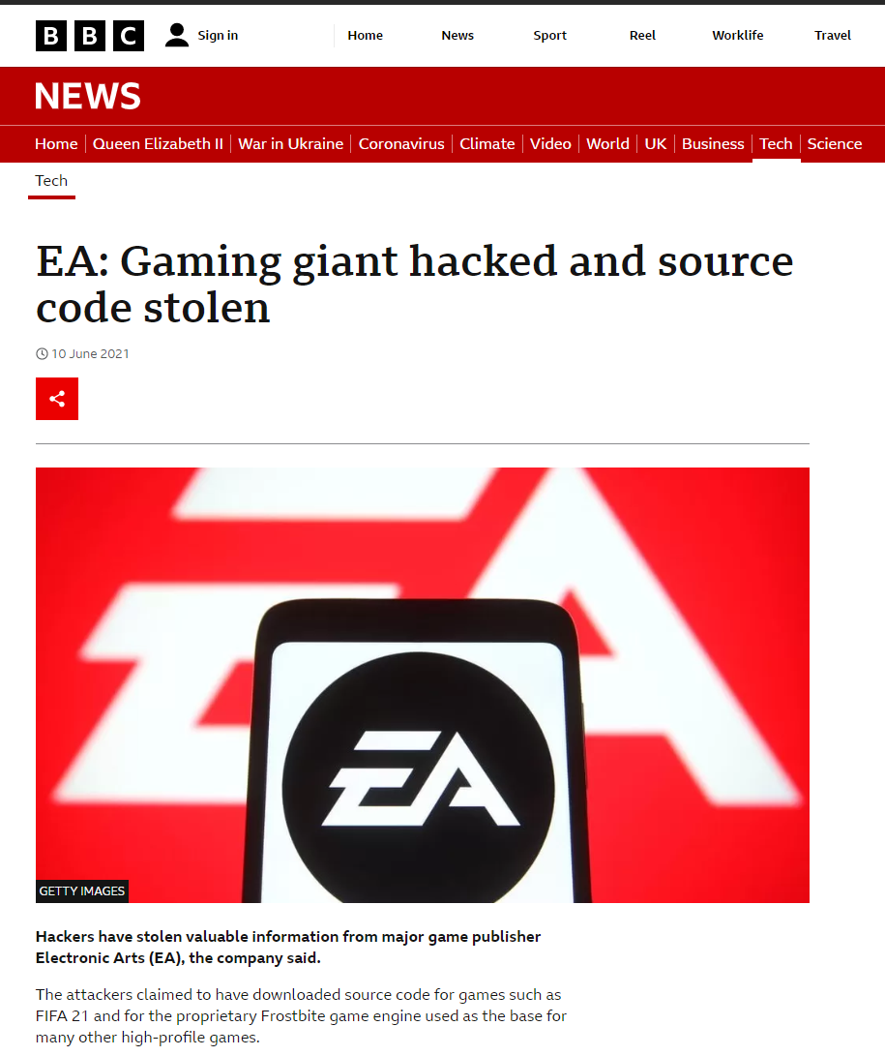
Steve Armstrong-Godwin
30 years in Security
Have been fighting hackers for 12+ years
Last role was at EA Games including when they were compromised
I led the Incident Management team to clean it up
New to the bank in June 2022 – I lead the SIRT Team in Cyber Ops

Slide 2

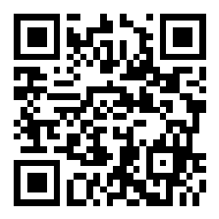
Hack Da Bank (HDB)
Helping you to stay safe by explaining what attackers do

Slide 3
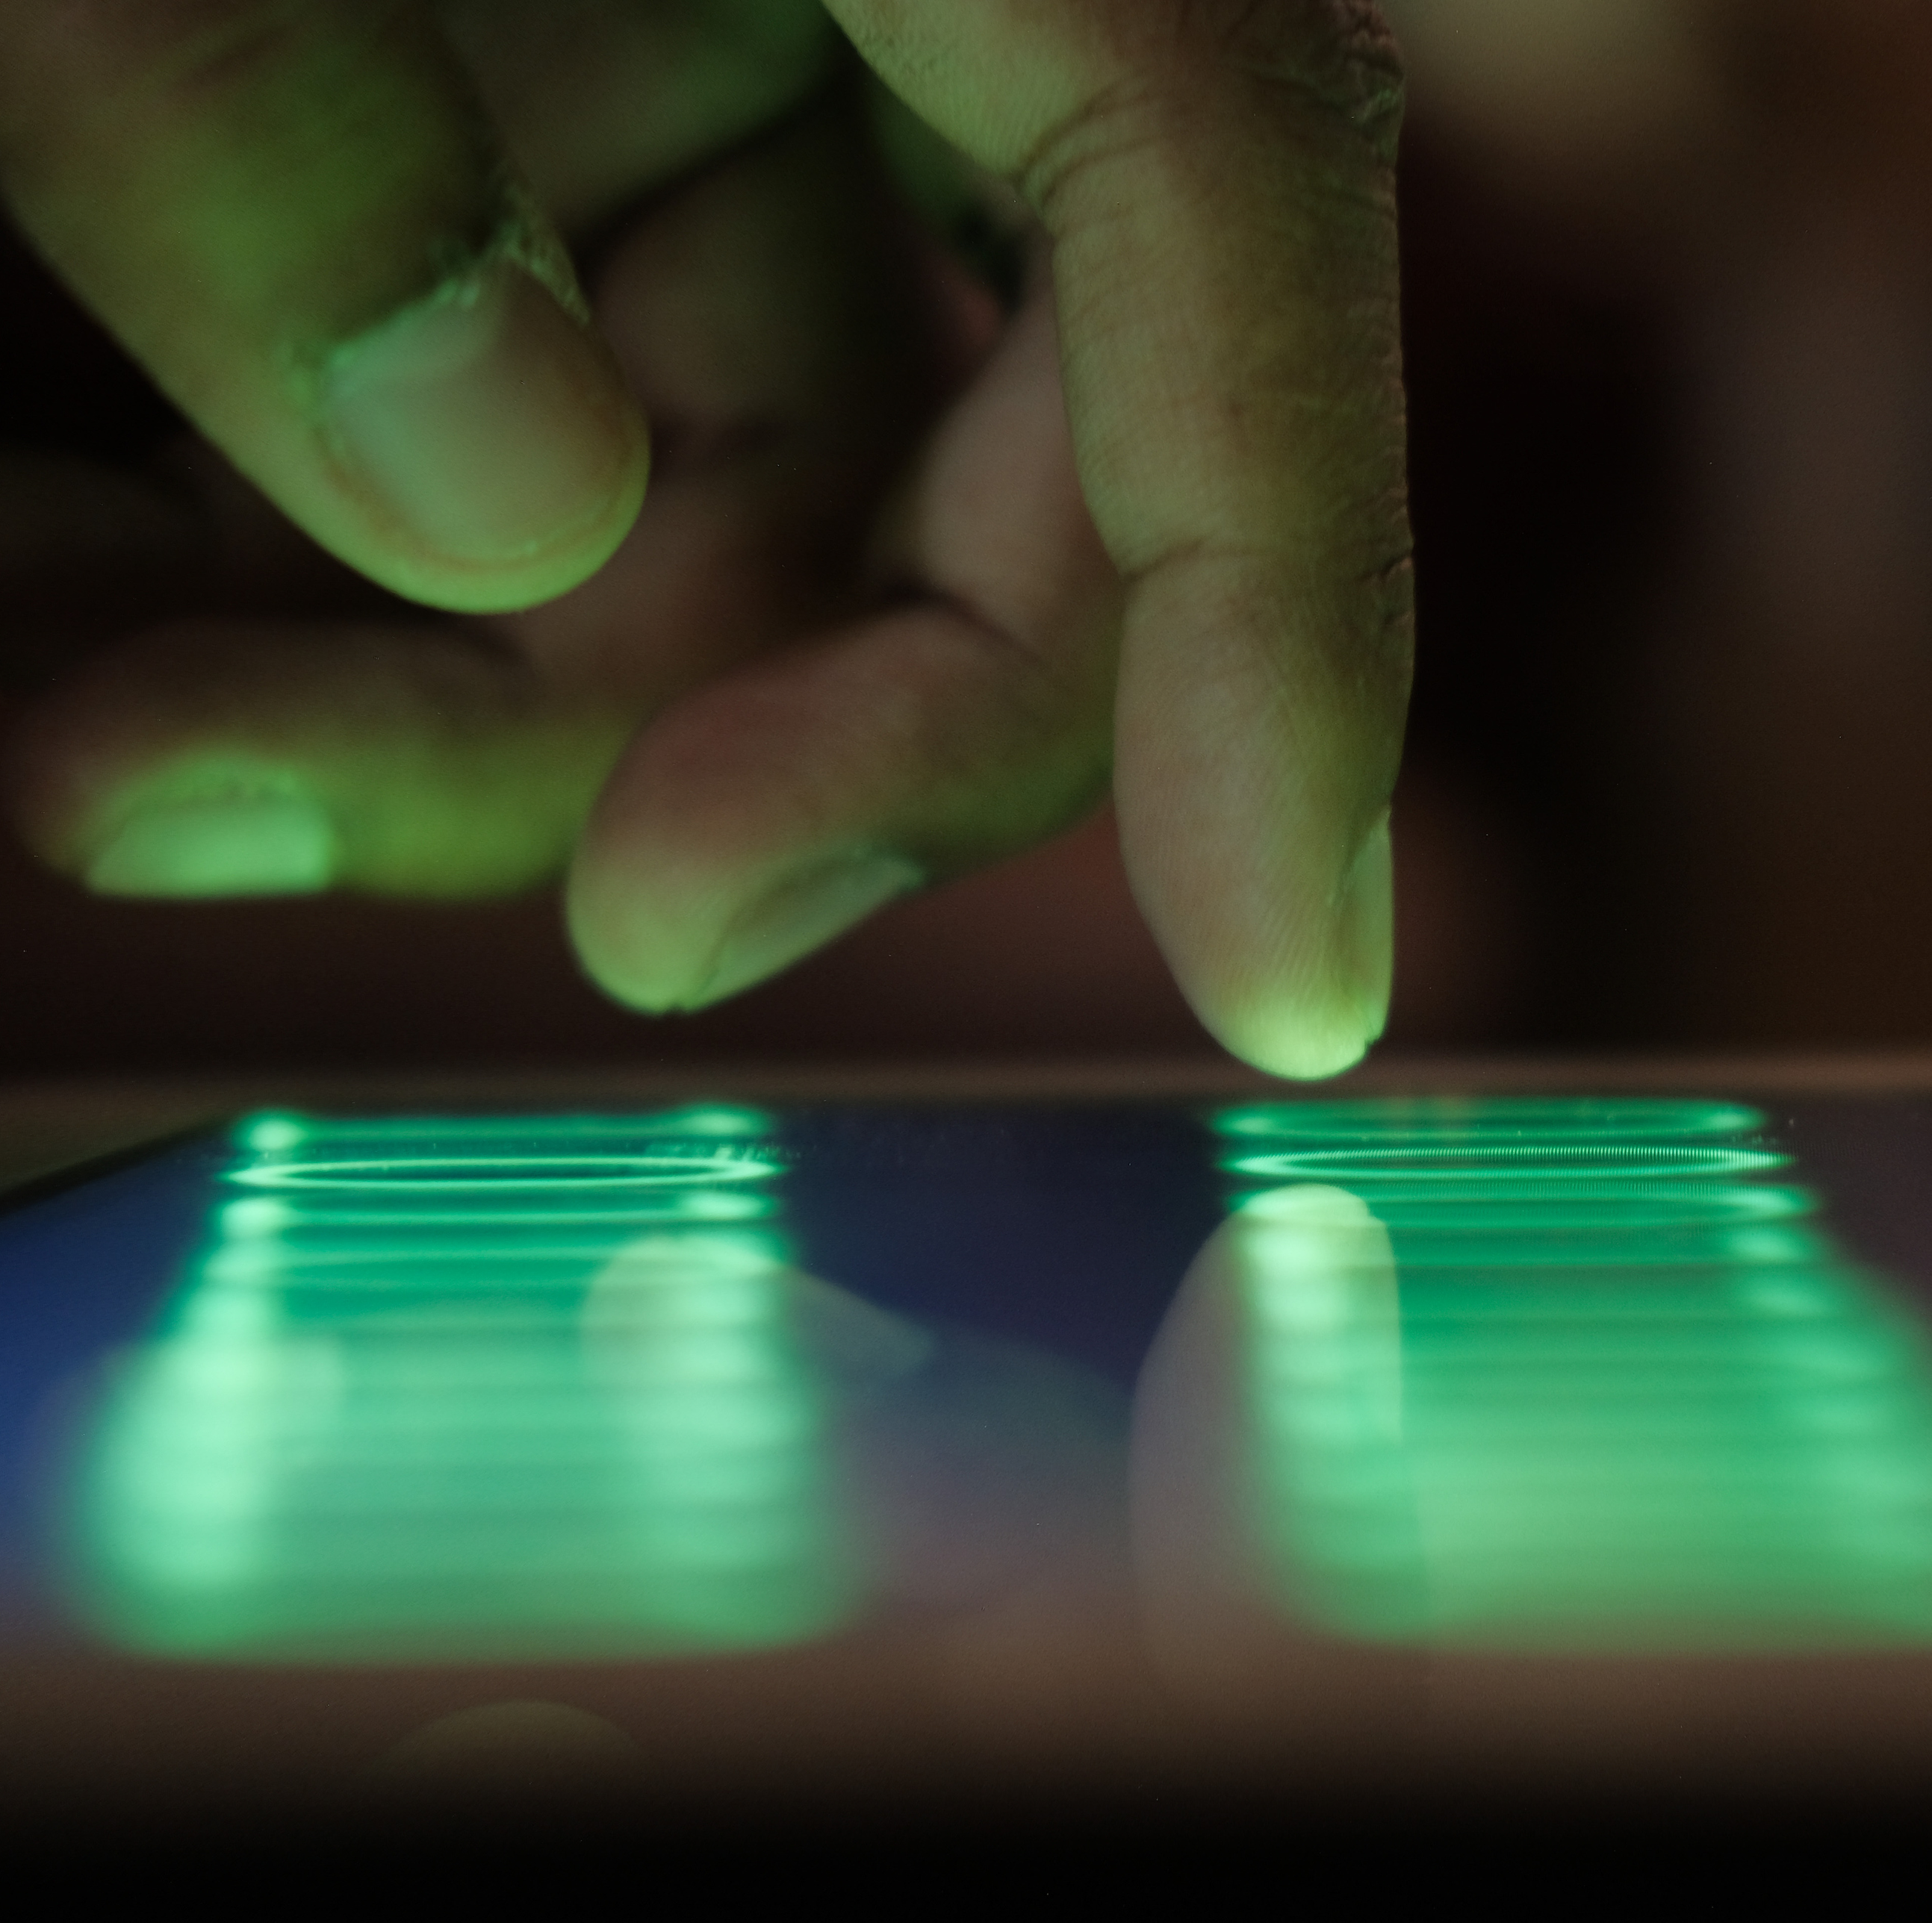
Internet safety
Who wants to hack you?
Malware/Phishing/Shadow IT
Multi Factor Authentication
Passwords
WIFI Safety
Mobiles
General security tips

Slide 4
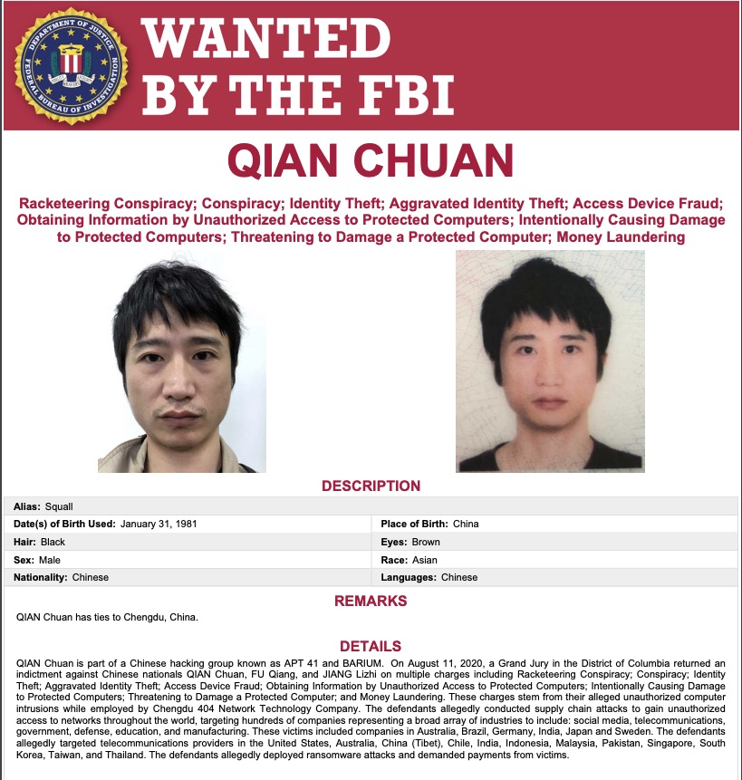
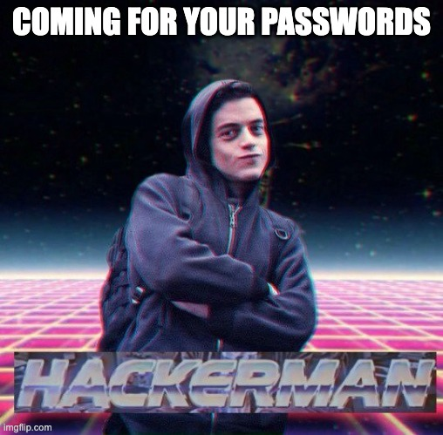
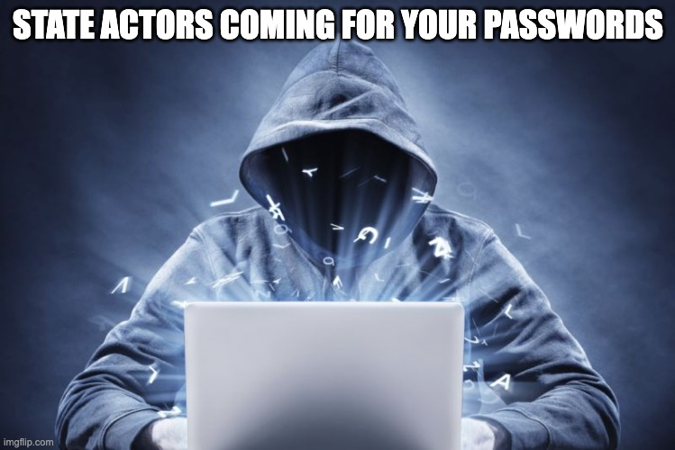
Getting your security level right

Slide 5
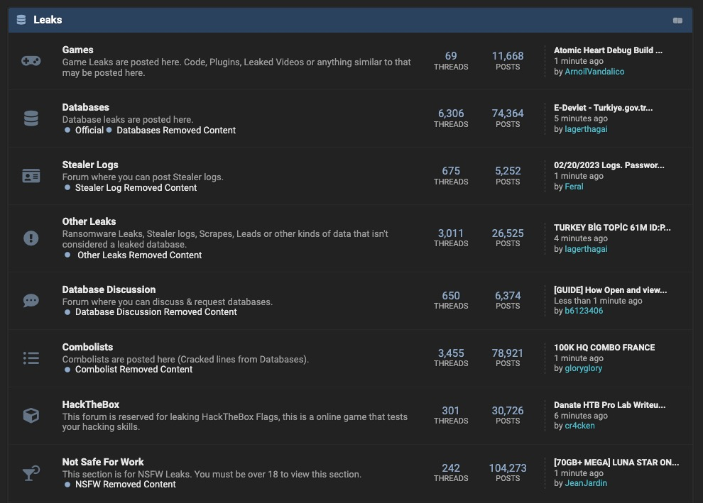
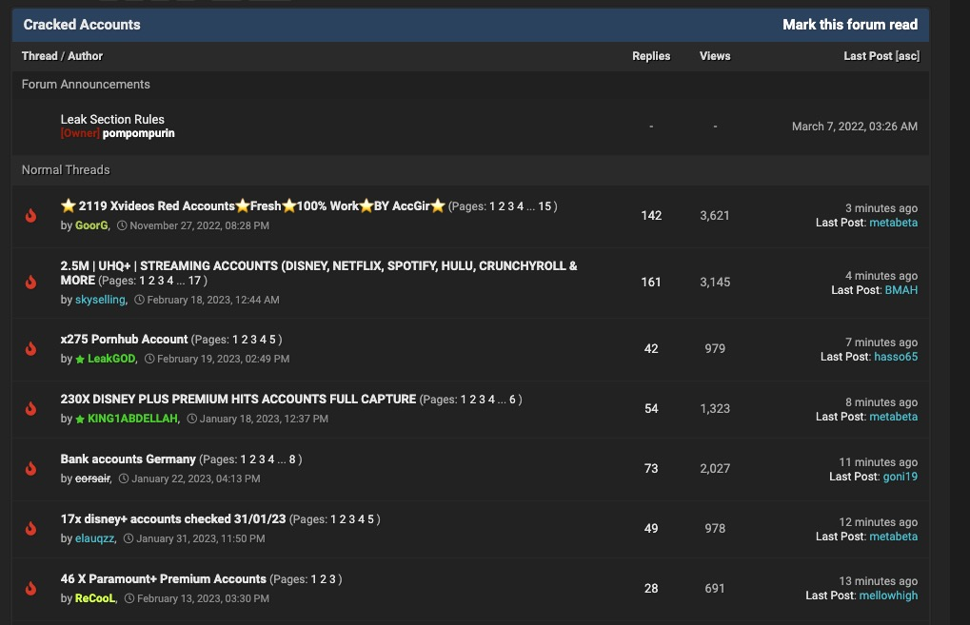
Your data has a value

Slide 6

Malware and Phishing

Slide 7
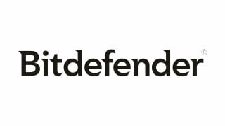


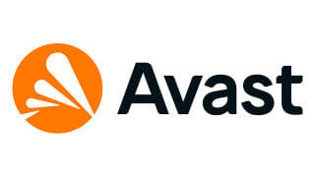


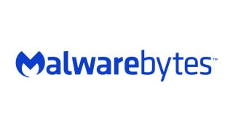
Buy a respectable Anti Malware product ensure it includes browser protection
Notes:
https://www.pcmag.com/picks/the-best-malware-removal-and-protection-software

Slide 8
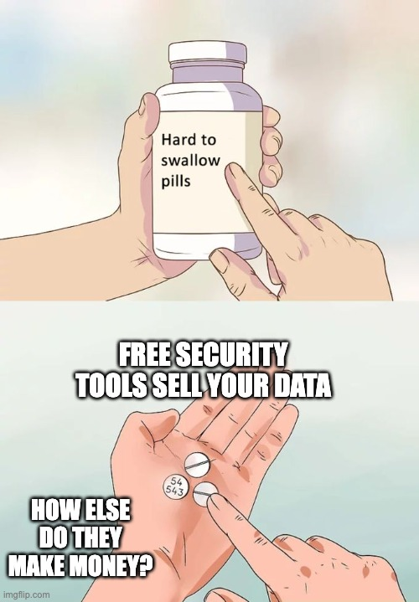

Don’t gamble with Free Security Products
Your personal data is worth more than nothing!

Slide 9
Attackers want to trick you to either:
Install malicious software (Malware/Trojans)
Use their cloud services to store sensitive data (Shadow IT)
Logon into sites that look legitimate (Phishing)
These have something inspectable ‘on’ your system

Slide 10
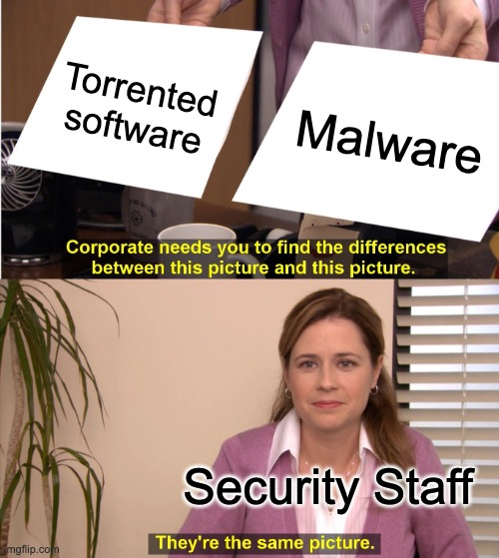
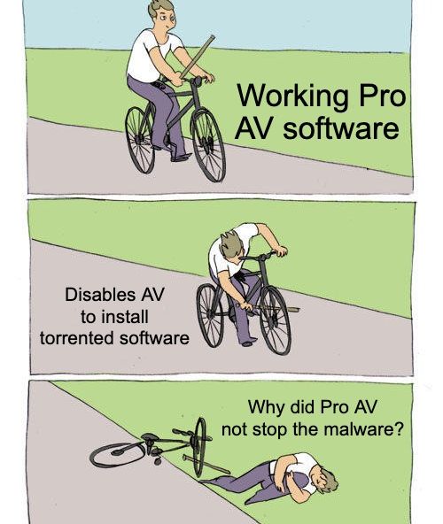
Don’t install cracked or p2p/torrented/shared software
Cracked software often contains malware
This requires the AV to be disabled to: “ensure the install goes well”
Typically, the OS asks for admin rights when installing software
At this point everything is compromised

Slide 11
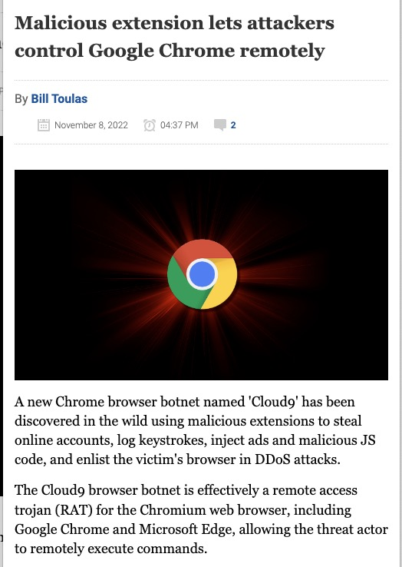
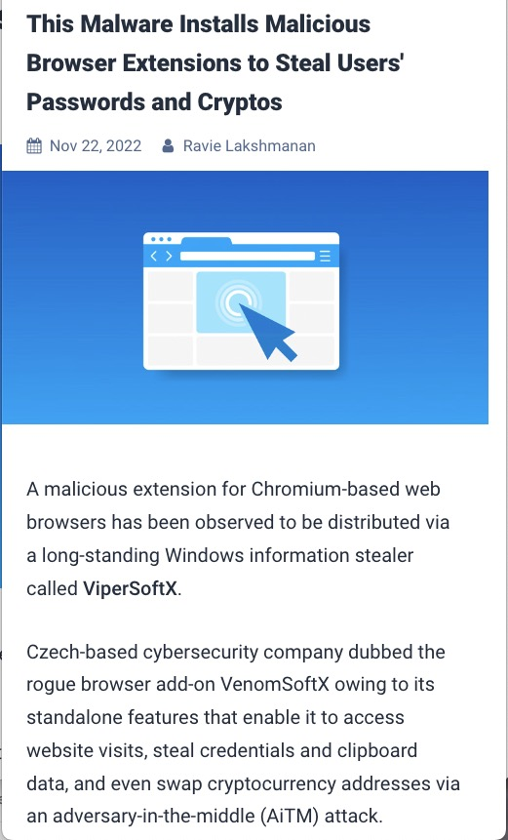
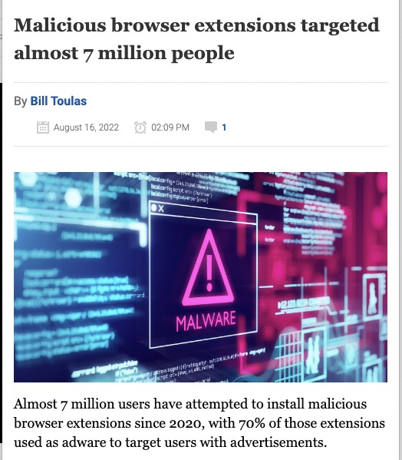
Not just the host operating system…
Browser
extensions
are typically
not covered
by free AV

Slide 12
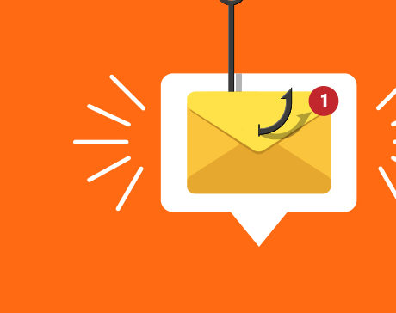
phishing
Pro AV will monitor emails and
will check the sites you are visit

Slide 13



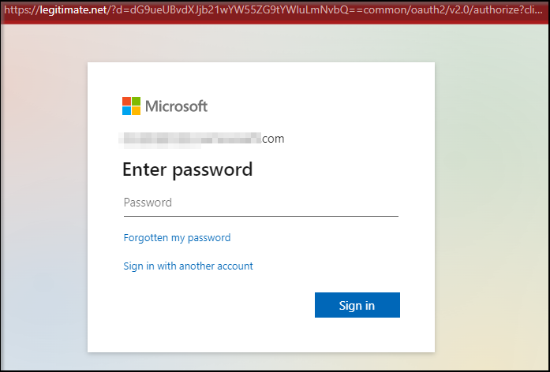


Your:
Username:Password
Your:
Username:Password

Slide 14

Dangerous/Unknown Applications (Shadow IT)
We all love free stuff, but with apps you have to remember:
”If you are not paying you are not the customer”
Let me show you how you can be tricked into sharing more than you maybe planned…..
I found this next site within 15 seconds

Slide 15
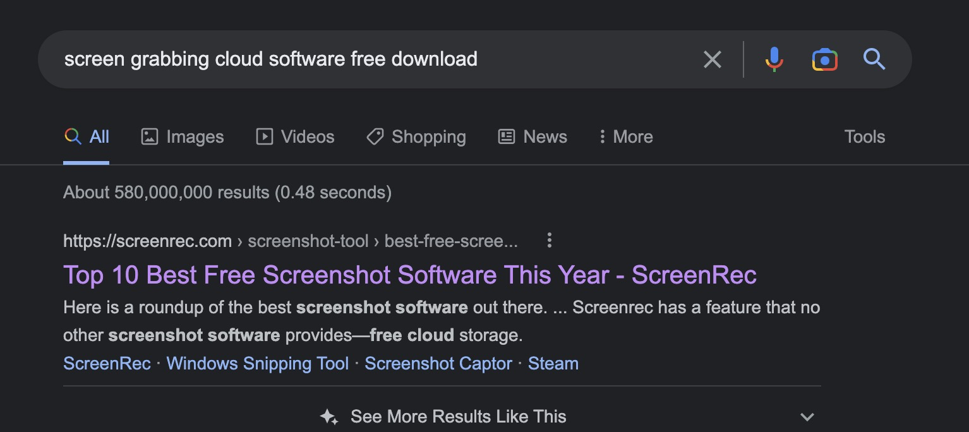
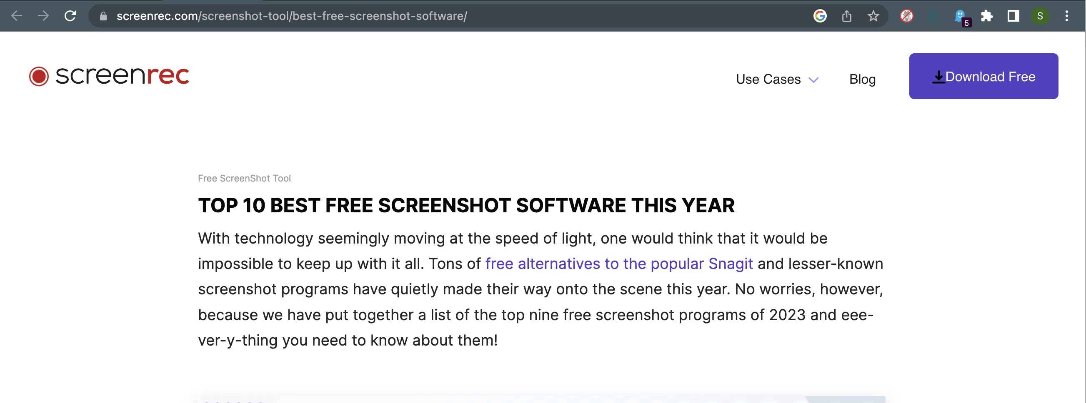
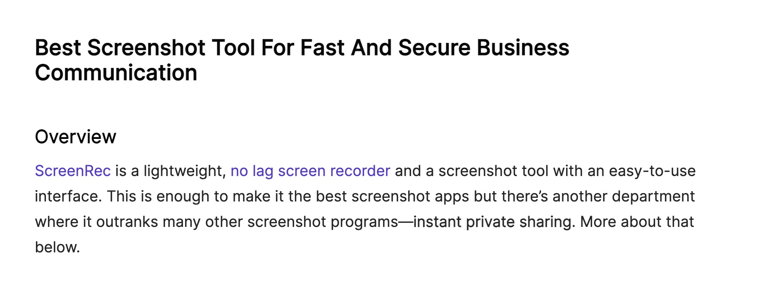
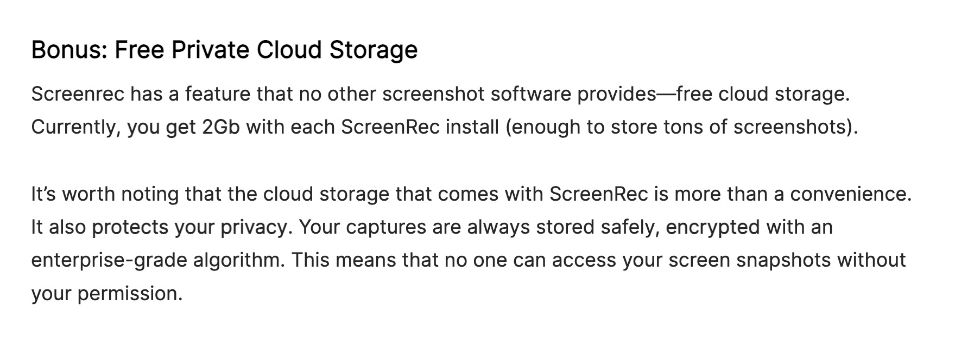

Slide 16
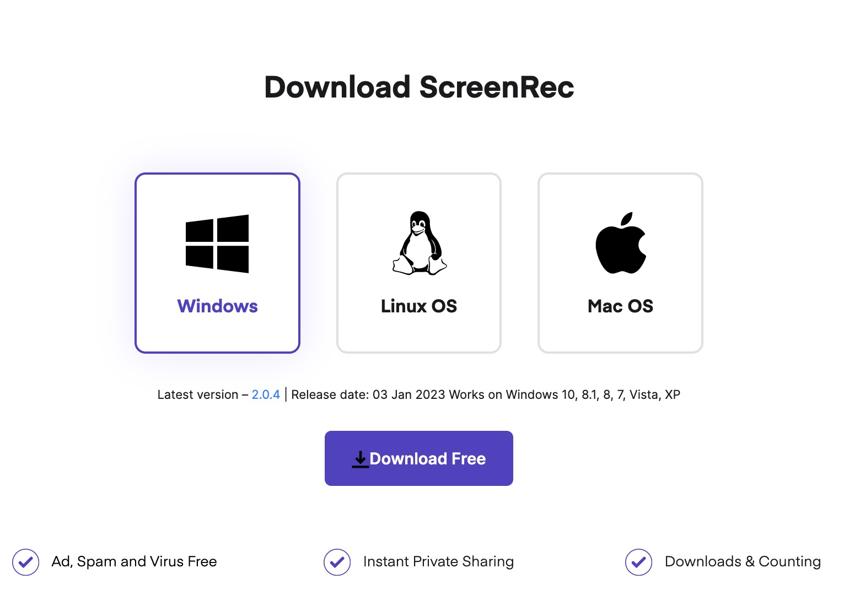
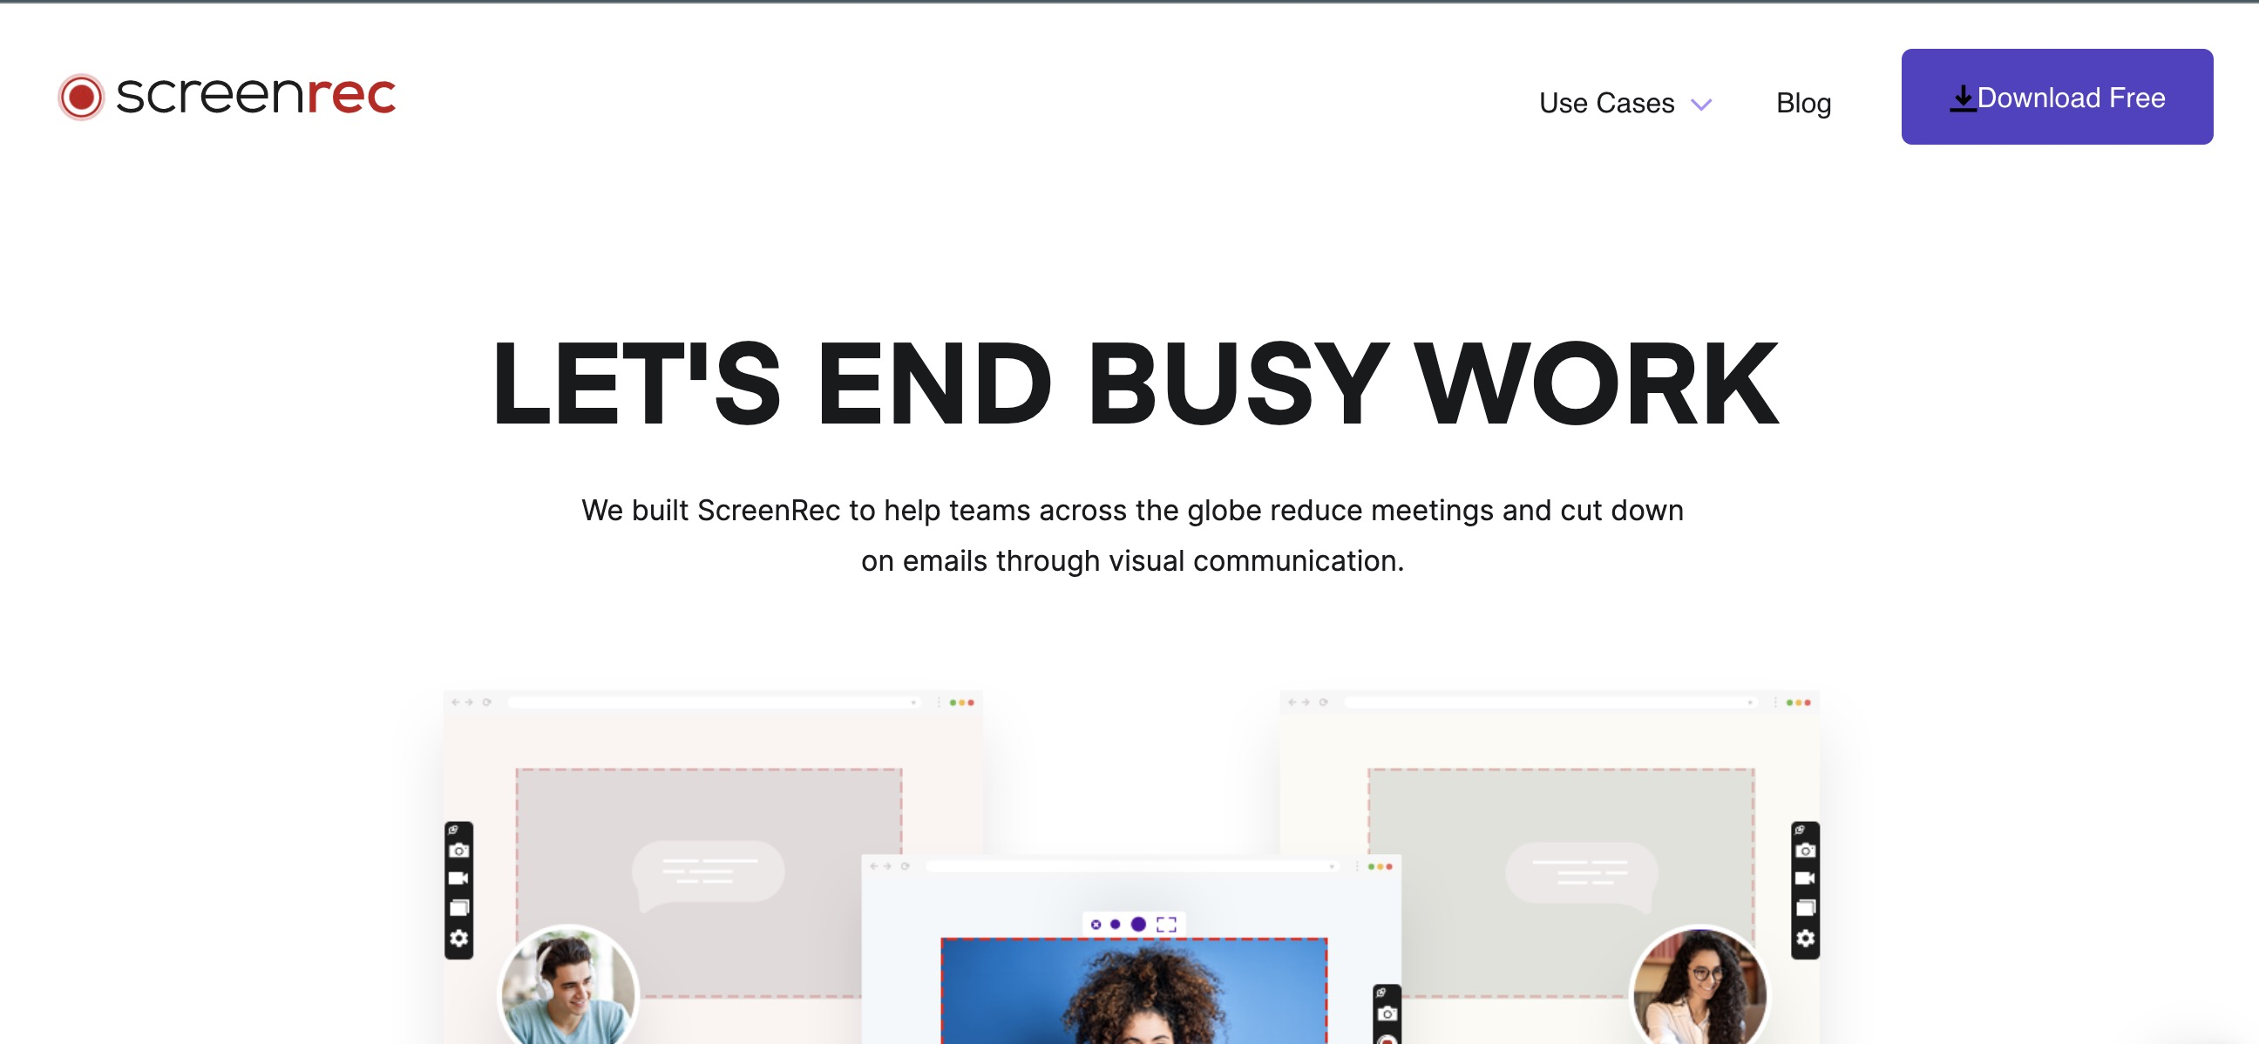
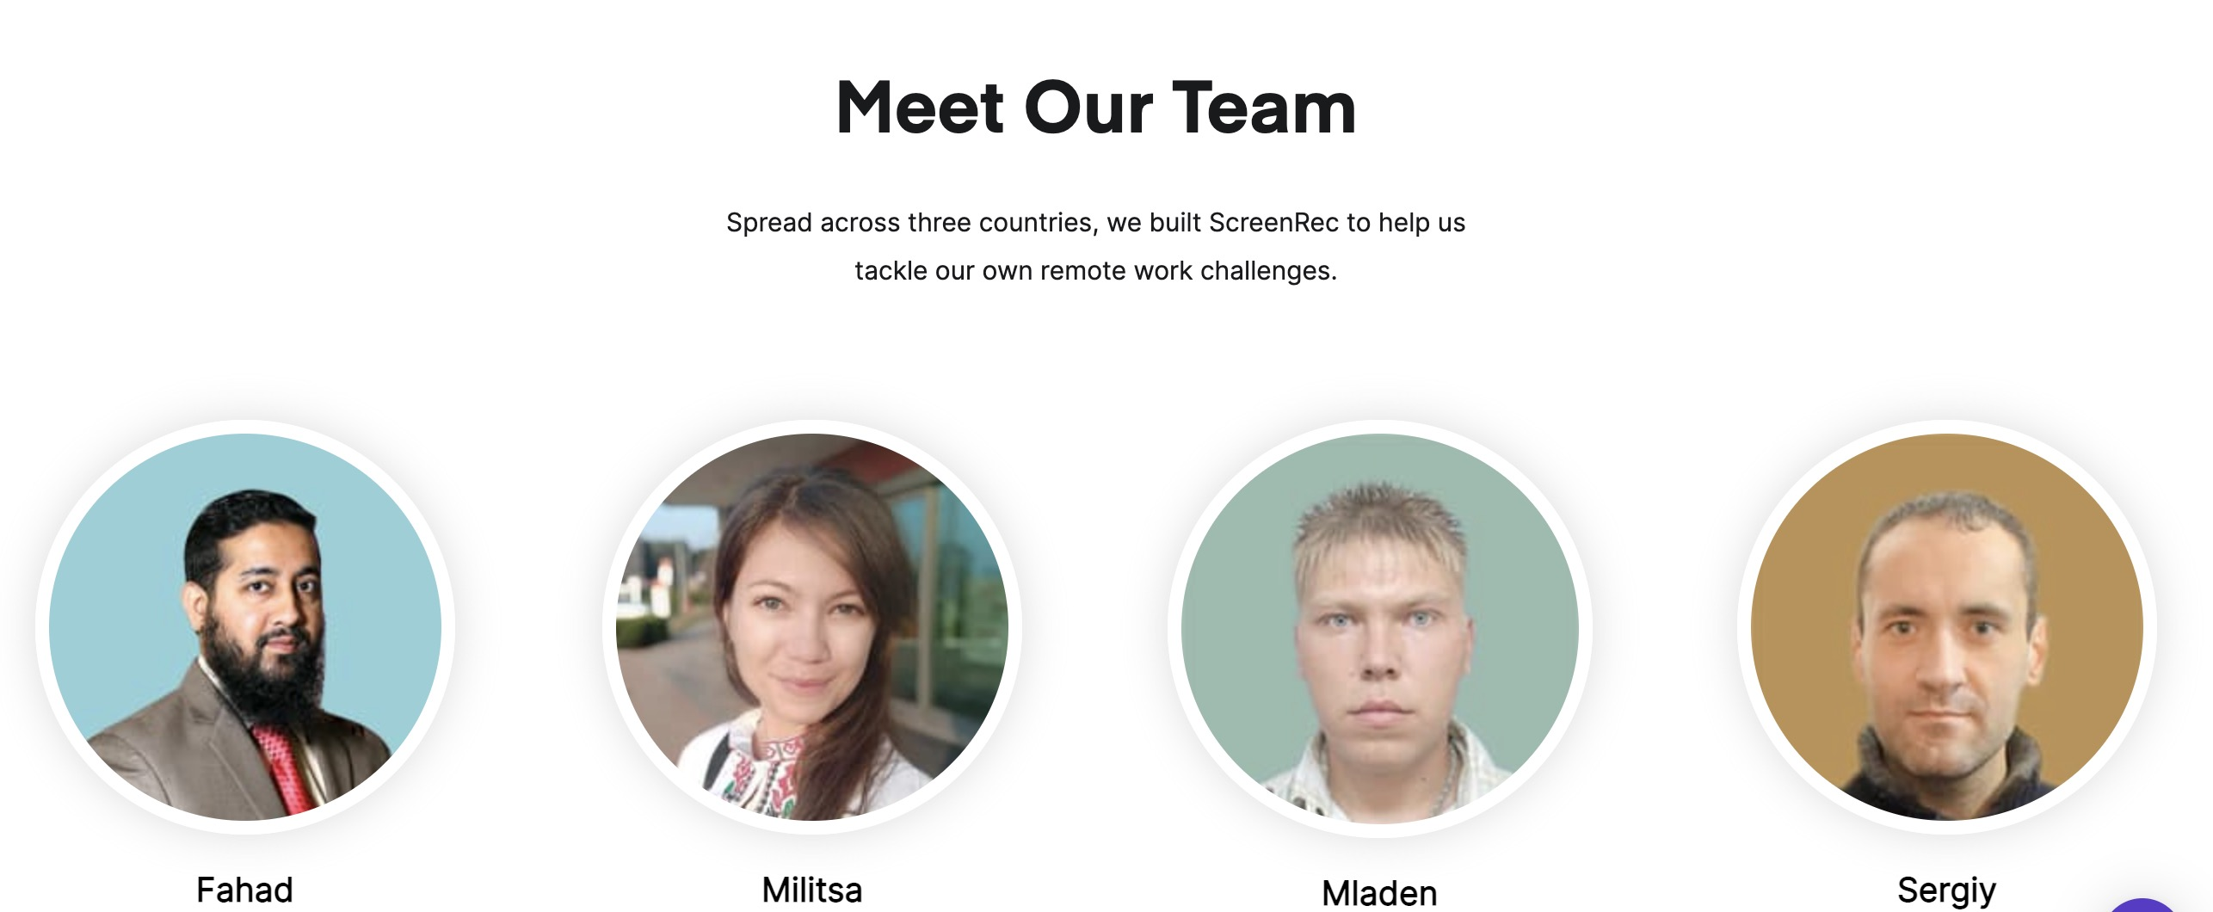
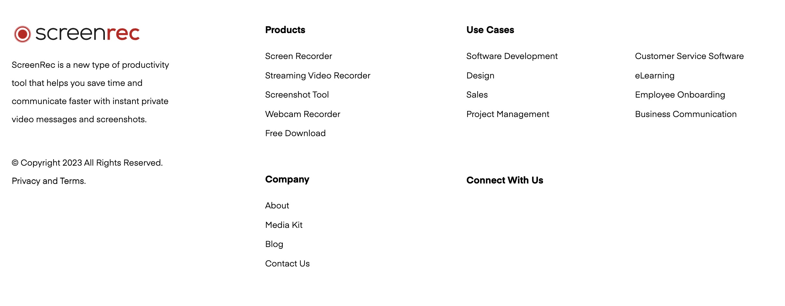

Slide 17
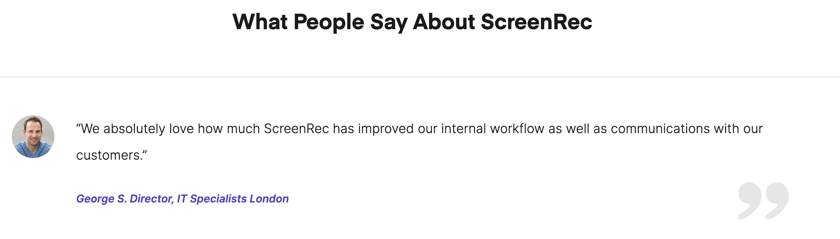
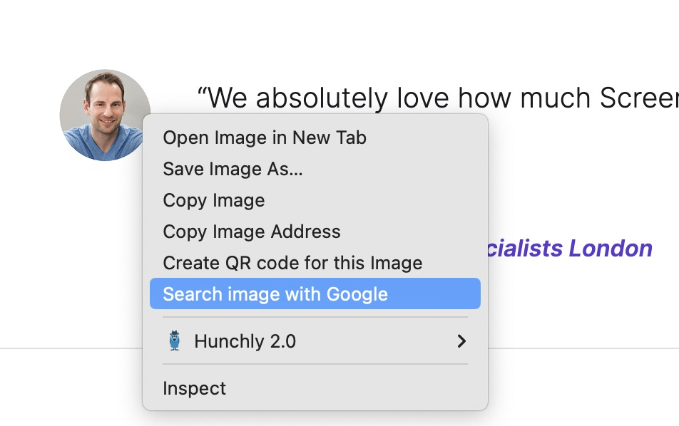

Slide 18
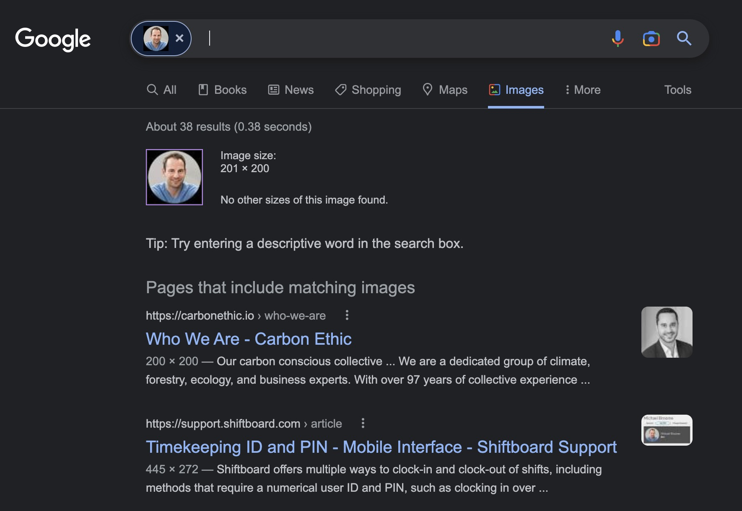
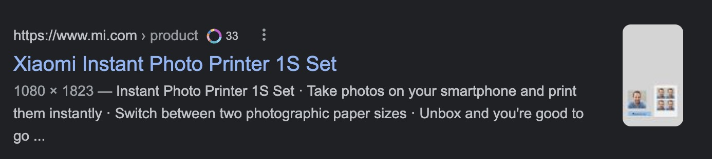
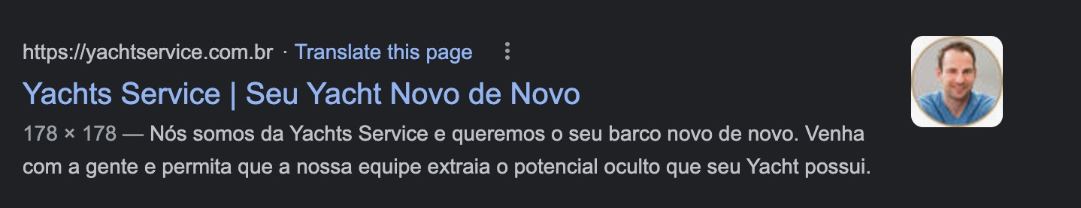
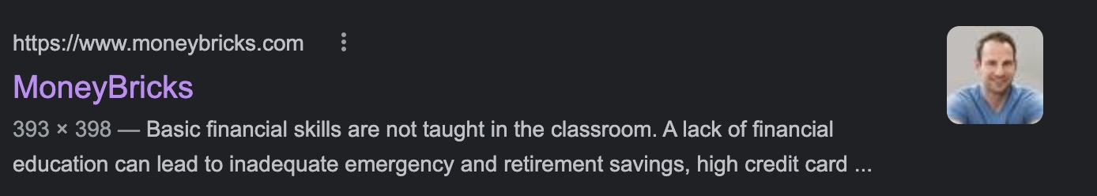
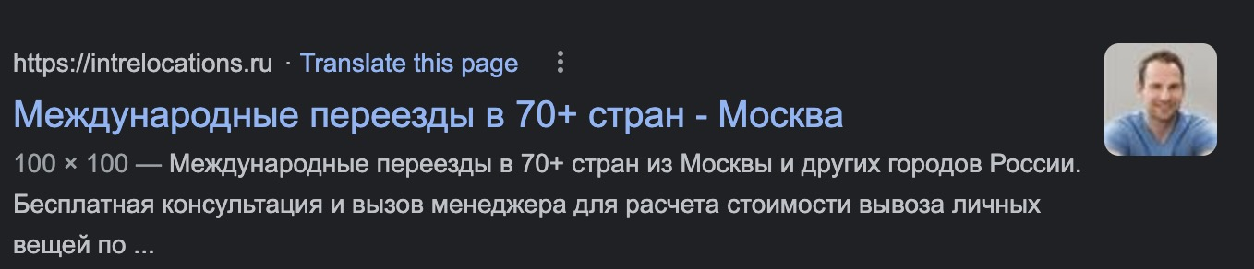
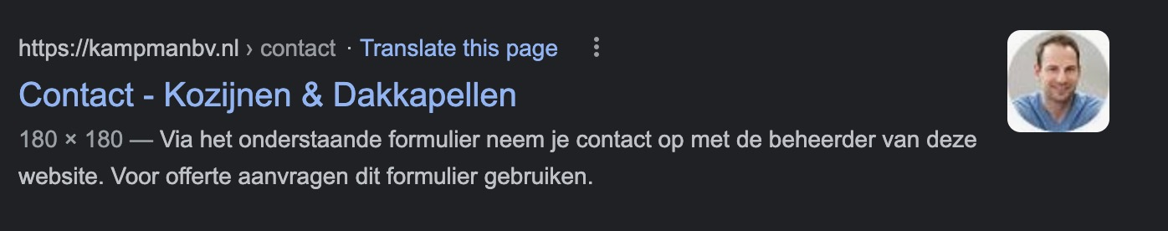
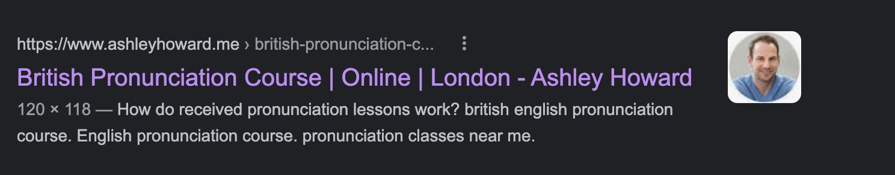

Slide 19
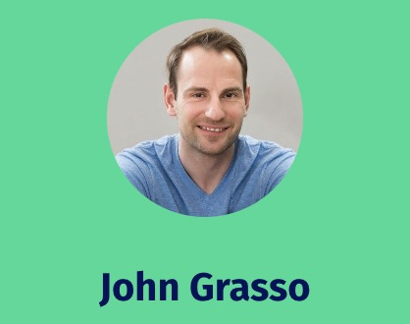
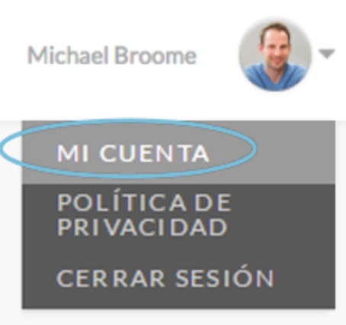
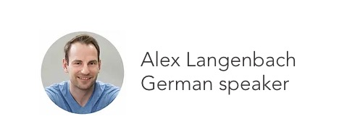
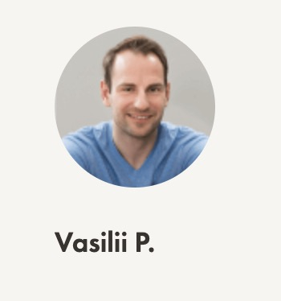
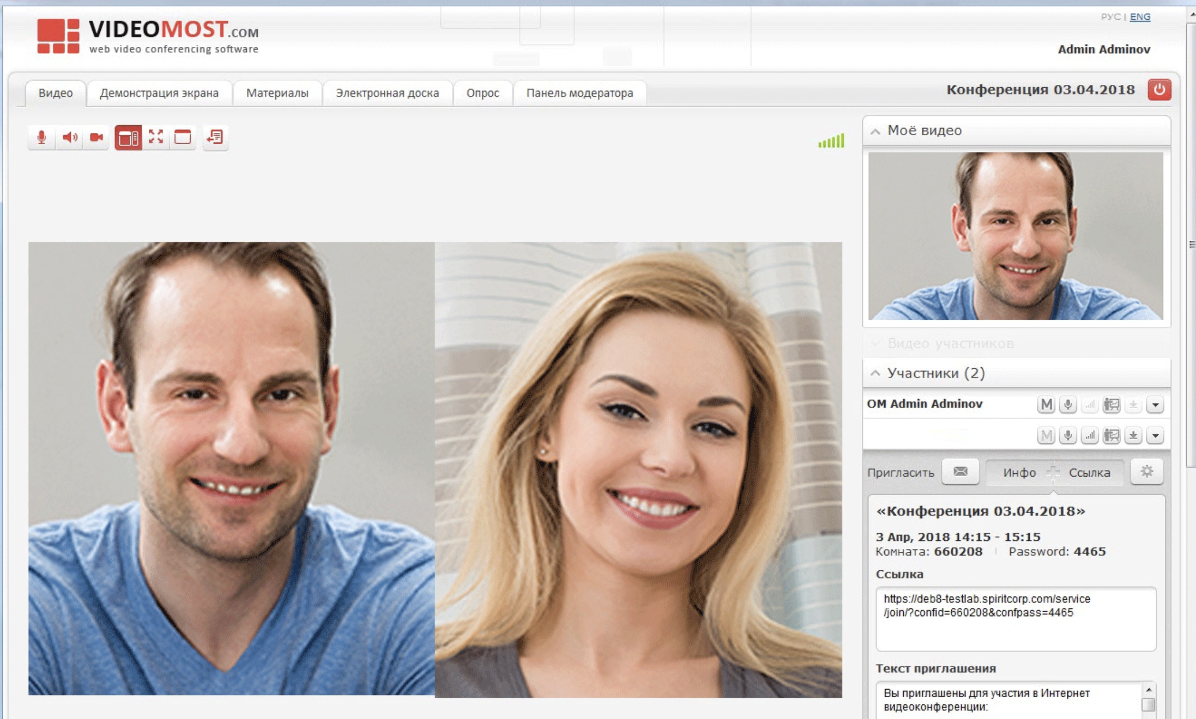
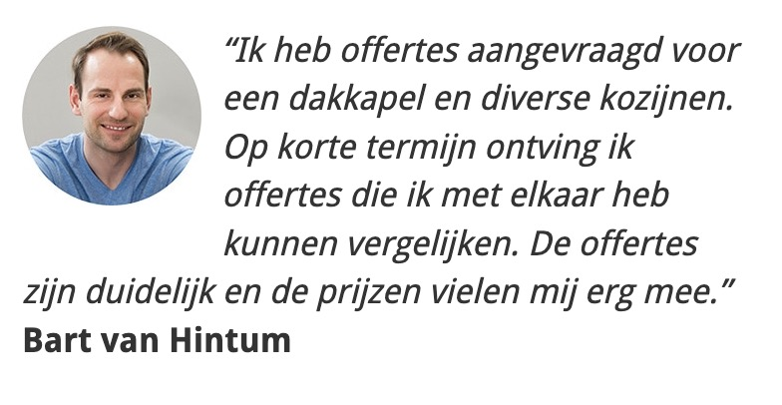

Slide 20
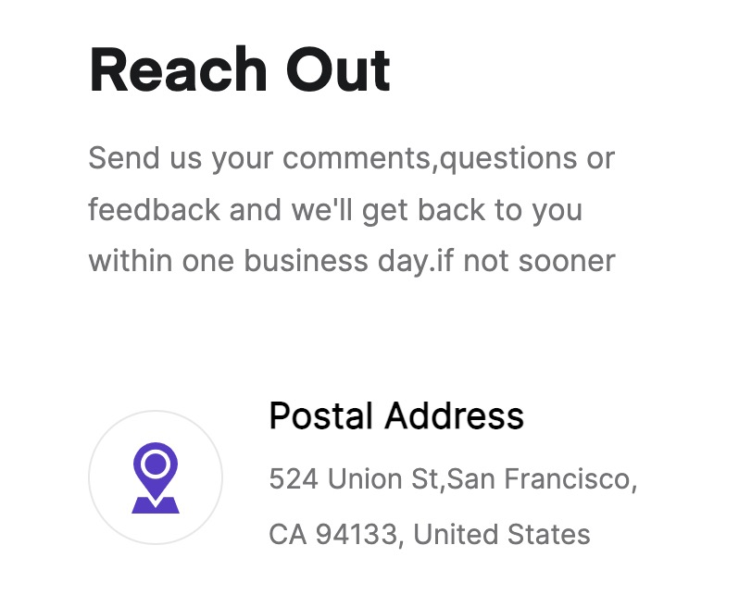
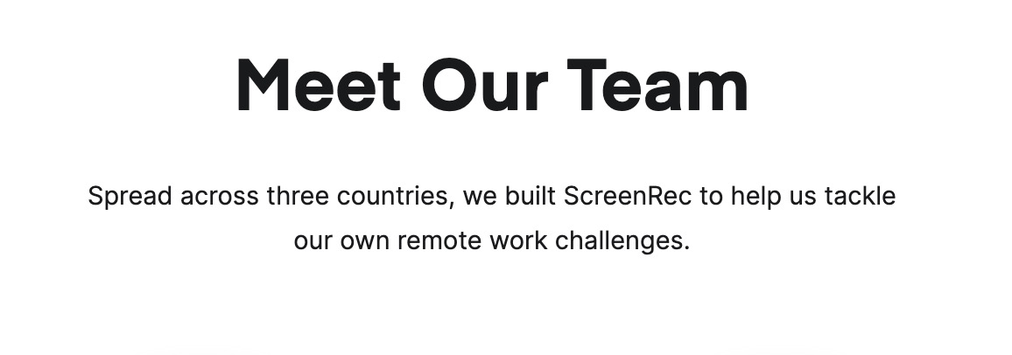
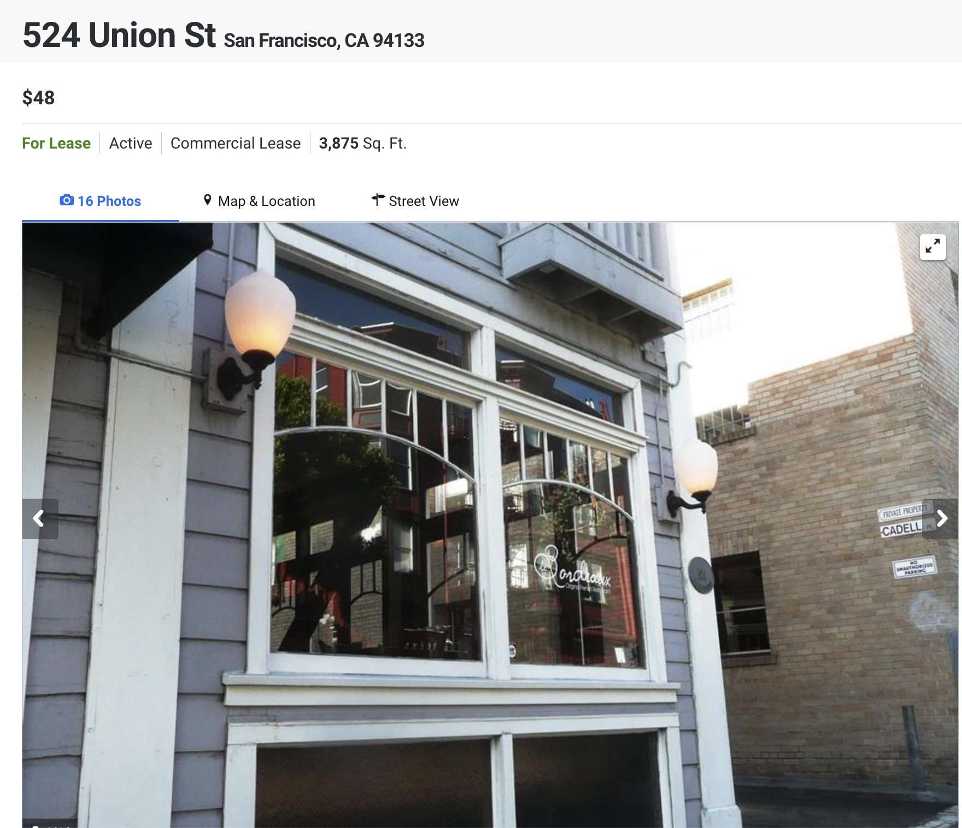
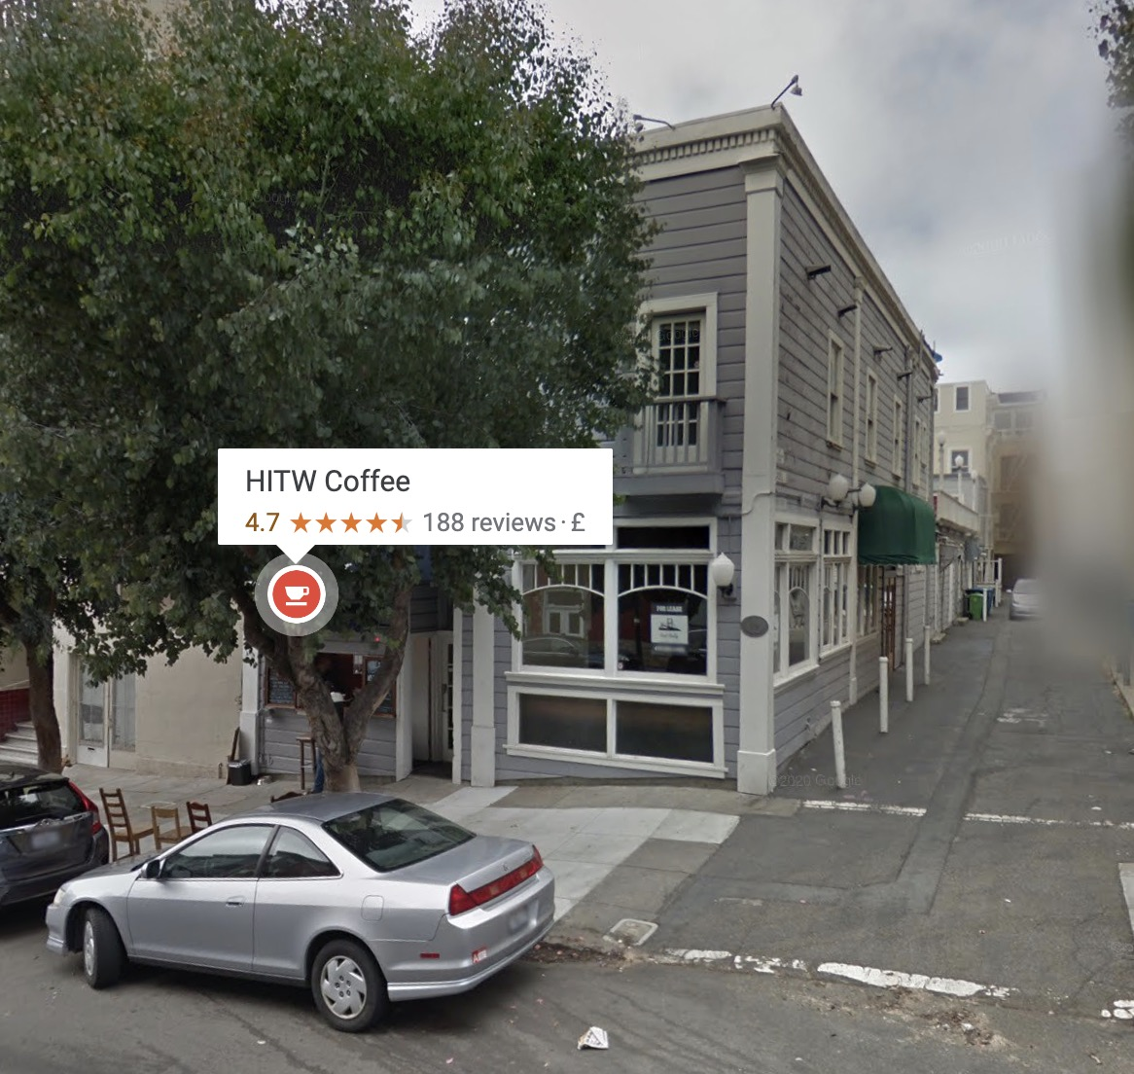
But where are they based?

Slide 21
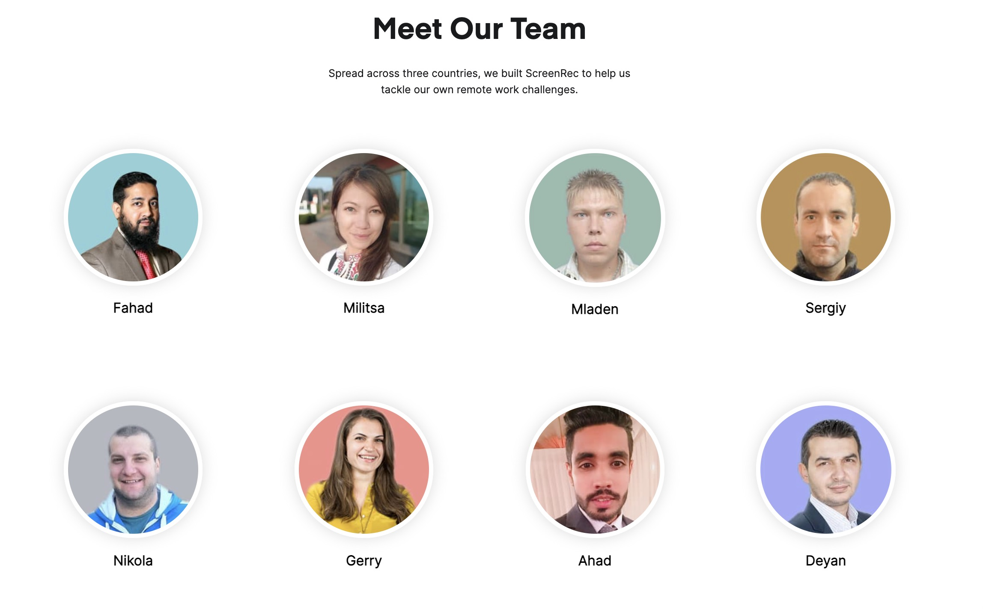
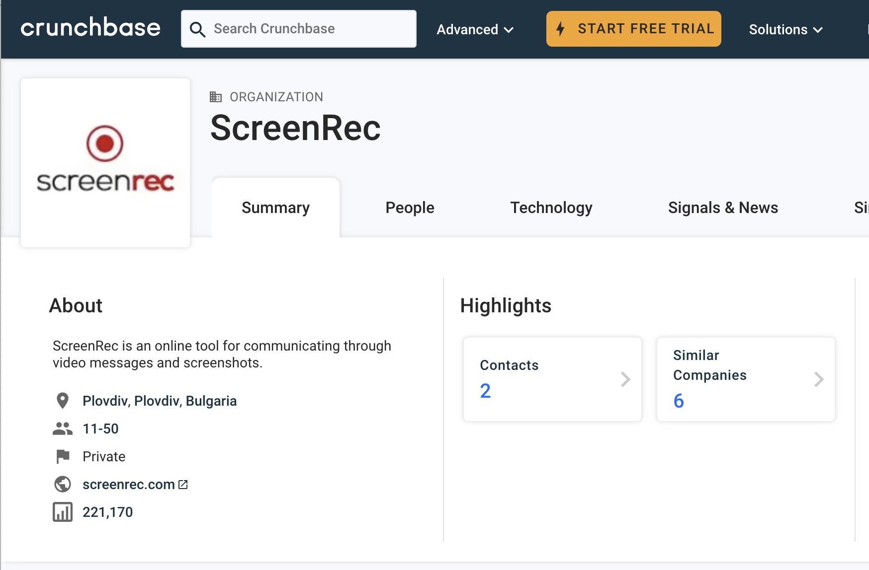
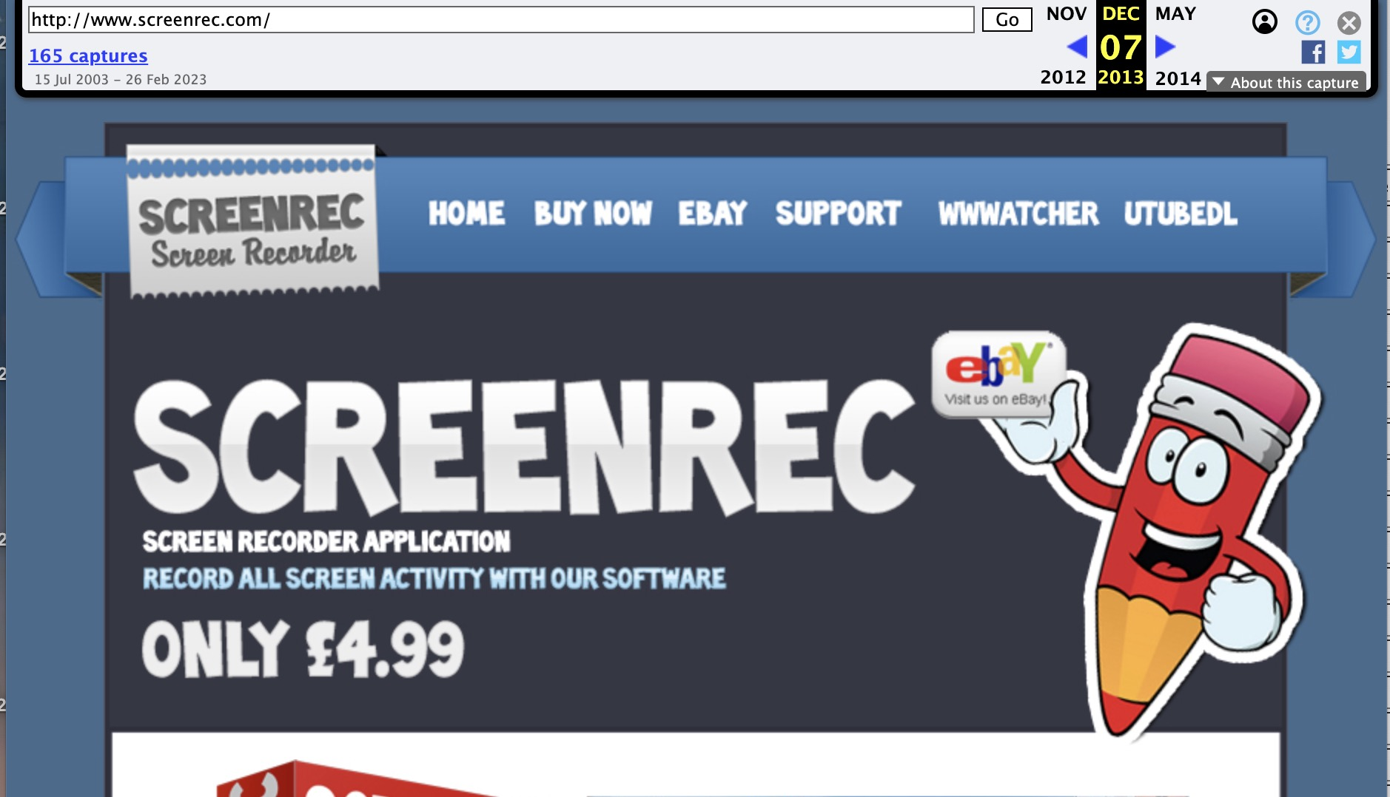
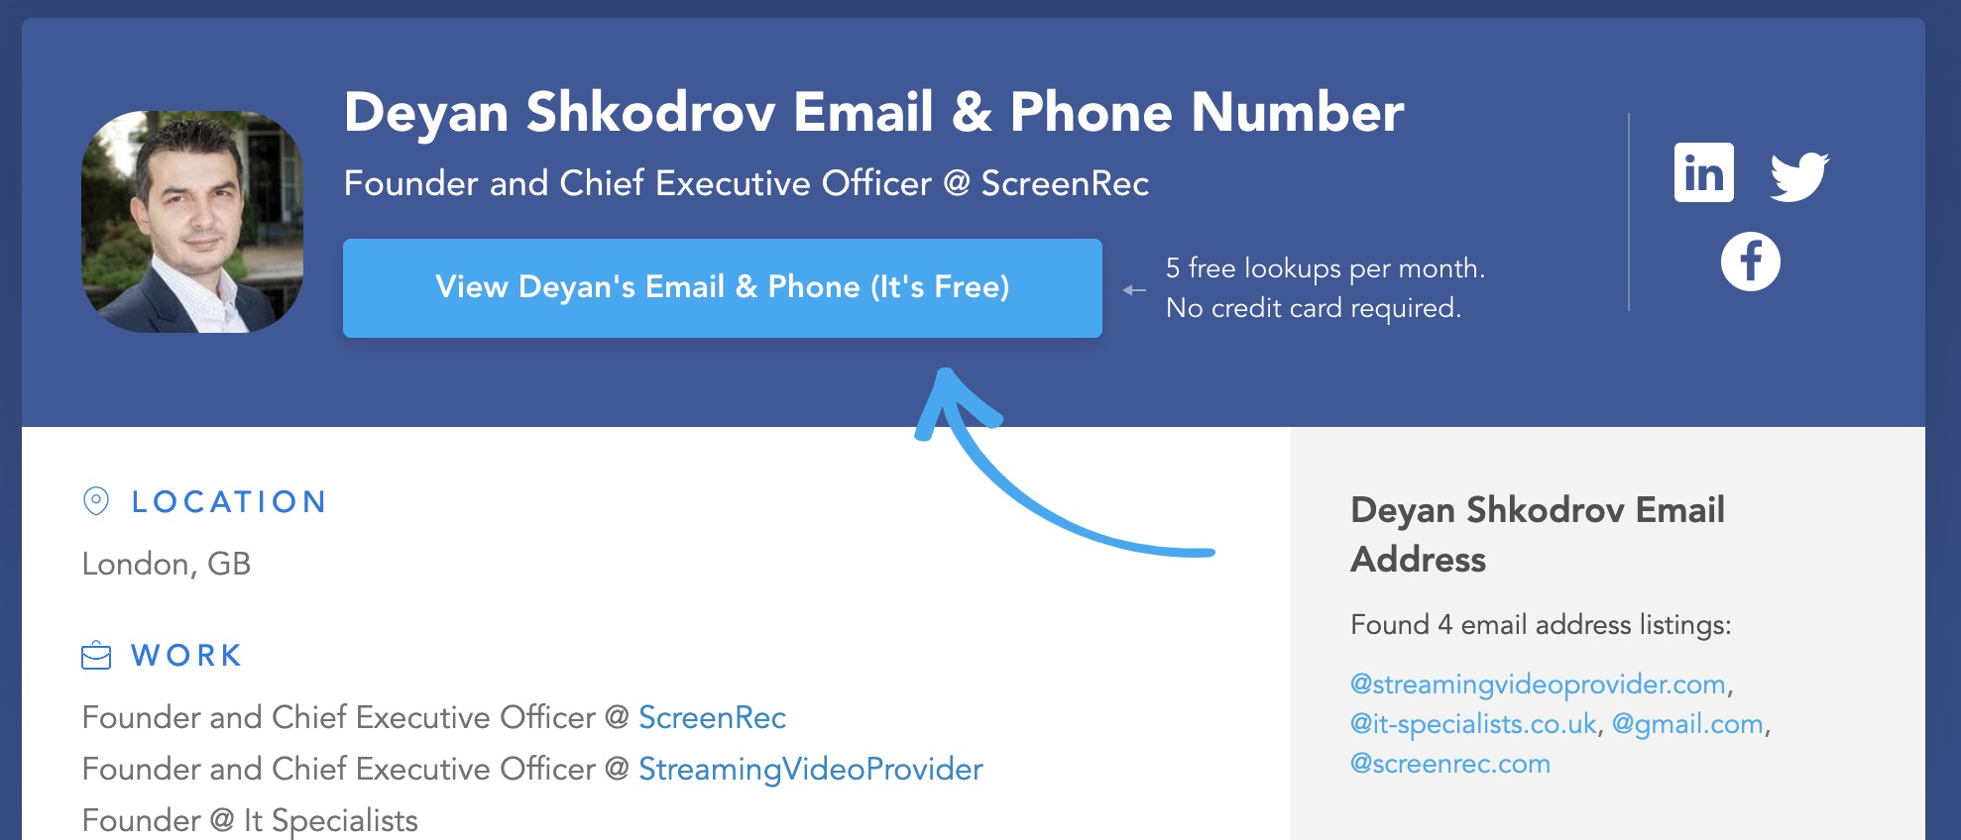
Hmmmmm

Slide 22

Do you think it’s safe?

Slide 23
So what have they got?
Malware OS:
Remote access, ability to start & stop any software (inc AV).
Can read any data including:
Username:Password
Tokens for all accounts
Can get all new passwords (via keystoke logger)
Phishing:
Username:Password
Location data
Malware Browser:
Username:Password
Tokens for all accounts
Live location data
Shadow IT:
Access to all data shared/copied and location data from sender
Tokens you say….

Slide 24

You get this when you open your browser?
This icon means my Google Token in my browser is giving me access to my data without the need to log in each day.
If the attacker has stolen this token from my system or browser, they can access all my data - on that account.
(Your ICON will be different)

Slide 25
Options: Take over / Extortion / Hijack
Take Over:
Change the details
Change the password
Sell the account access
Extortion:
Export data
Possibly destroy data
Demand payment
Hijack:
Read the email
Leave password untouched
Use the account access

Slide 26

Hijack Options
Trick others to install malware
Phishing emails to your friends
Hijack older conversation with business partners(invoice attacks)
Later extortion options (based upon content)
Reset all other accounts (look for the sign-up emails)

Slide 27


15 mins on GMail

Slide 28

Best protection is: Multi Factor Authentication

Slide 29



Which one?
Not great but better than nothing
Great!
SMS

Slide 30
Logon flow with MFA
Username:Password
to logon page on site.
Site does MFA Challenge:
User gives valid Response.
Token issued to user
Stored in browser.

Slide 31


Token trading

Slide 32

Protection
Check your browser-based accounts for login locations
On a regular basis expire all sessions – especially if changing your password
Review your plugins on a regular basis

Slide 33

Passwords

Slide 34

Managing passwords is not easy
Internally KeyPass for:
Admin passwords
Complex hard to remember passwords

Slide 35




For your personal devices:
Apple Cloud (keychain) for your passwords on iPads, iPhones, Macs
Password Manager for browsers (Dashlane , 1Password Keeper etc )
Not LastPass as they have structural problems
Browser stored passwords (Chrome, Edge, Opera etc)
If someone knows your system operating system password, they can export all your stored passwords

Slide 36





WiFi Safety

Slide 37
WiFi Safety (Fake Access Point)
Free Internet!
IP: 192.168.0.1

Slide 38


WiFi Safety (eavesdropping)
Free Internet!
IP: 192.168.0.1
Bunnies-R-Us

Slide 39
WiFi Safety (DNS Attack 1)
DNS = Domain
Name Service
Free Internet!
WPA2/WPA3
IP: 192.168.0.100
IP: 192.168.0.1
Bunnies-R-Us
DNS
Server
Recursive DNS
“Lookups”

Slide 40

WiFi Safety (DNS Attack 2)
DNS = Domain
Name Service
Evil DNS
Server
Evil
Website
Free Internet!
WPA2/WPA3
IP: 192.168.0.1
IP: 192.168.0.100
IP: 192.168.0.1
Bunnies-R-Us
DNS
Server
Recursive DNS
“Lookups”

Slide 41

Mobile Devices
Same issue regarding WiFi
Who owns it and is it safe?
Apps stores
Permissions

Slide 42


App Stores
The only safe place is Apple Store or Google Play
However……

Slide 43



Even these can be tricked and contain malware

Slide 44




Notes:
https://cybernews.com/privacy/android-apps-are-asking-for-too-many-dangerous-permissions-heres-how-we-know/

Slide 45

Takeaway Time!

Slide 46

General Security
Multi Factor your main email account!
If you lose this, you can lose everything!
Then MFA everything else (inc your mobile)

Slide 47

Website Takeaway
Websites can be deceiving
Use apps that have been checked
Ask yourself: “how do they make money?”
If in doubt, ask security before you install it
Don’t rely upon recommendations by others

Slide 48

Regularly remove stuff you don’t use
Last day of the month
Next time you are sat bored in a waiting room
Start at the ones farthest from the home page:
These are used least
or you’d have moved them
On the topic of deleting…

Slide 49

Your failsafe to protecting weeks of work and years of photos etc.
Make them each month and keep them offline (disconnected)
Plug a phone into a computer to back it up to a removable hard drive
Set reminders to ensure you do regular backup (last day of the month)
Criminals can target users photos, years of memories, for extortion

Slide 50

Wireless
If you don’t need WiFi don’t join it
Tethering is safer and often ‘free’
Look for encryption (WPA2/WPA3)
Guide Remember that unless you set your own, you use their DNS (network directions)

Slide 51


Secure your DNS!
Change your DNS provider (on your WiFi Router) and mobiles:
Open DNS https://www.opendns.com/home-internet-security/
Cloudflare https://blog.cloudflare.com/introducing-1-1-1-1-for-families/
Notes:
Malware Blocking Only Primary DNS: 1.1.1.2 Secondary DNS: 1.0.0.2
Malware and Adult Content Primary DNS: 1.1.1.3 Secondary DNS: 1.0.0.3
For IPv6 use:
Malware Blocking Only Primary DNS: 2606:4700:4700::1112 Secondary DNS: 2606:4700:4700::1002
Malware and Adult Content Primary DNS: 2606:4700:4700::1113 Secondary DNS: 2606:4700:4700::1003

Slide 52

Other tips (if we have time)
When not in use:
Cover cameras on laptops
Point webcams down
Or cover with a cloth
User different browsers for different things
Banking
YouTube
Social Media etc
Don’t give kids admin level access on the system you bank on
Keep backups offline

Slide 53
Hand back…

Slide 54

Family Focused
Security for your family

Slide 55

Family protection https://safety.google/families/

Slide 56

Family protection (https://account.microsoft.com/family/home)

Slide 57


Device Family Settings
Apple: https://support.apple.com/en-gb/guide/iphone/iph00ba7d632/ios
Android: https://support.google.com/families/answer/7103262
Notes:
Apple: https://support.apple.com/en-gb/guide/iphone/iph00ba7d632/ios
Android: https://support.google.com/families/answer/7103262

Slide 58
WiFi Safety (eavesdropping)
Free Internet!
WPA2/WPA3
IP: 192.168.0.100
IP: 192.168.0.1

Slide 59
Laptop Security
DNS = Domain
Name Service
Free Internet!
IP: 192.168.0.100
IP: 192.168.0.1
Evil
Website
DNS
Server
Recursive DNS
“Lookups”

Slide 60
Laptop security [DB laptop] attack vectors:
o Infrastructure –DNS & Wi-Fi (includes explainers).
o Dangerous applications and how to avoid them.
o Shadow IT (how it is dangerous).
Mobile security (looking at malicious apps):
o The rise of malicious apps.
o Where to get safe apps from.
o What to look for in the app store.
o Alarming permissions for apps.
Home network security steps:
o Routers.
o Wireless.
o Other devices.
o What to do with older equipment.
Passwords:
o Good password management.
o When you can reuse a password (some you can).
General account security:
o Email security.
o Social media security.
Notes:
What I will cover:
- Laptop security [DB laptop] attack vectors:
o Infrastructure –DNS & Wi-Fi (includes explainers).
o Dangerous applications and how to avoid them.
o Shadow IT (how it is dangerous).
- Mobile security (looking at malicious apps):
o The rise of malicious apps.
o Where to get safe apps from.
o What to look for in the app store.
o Alarming permissions for apps.
- Home network security steps:
o Routers.
o Wireless.
o Other devices.
o What to do with older equipment.
- Passwords:
o Good password management.
o When you can reuse a password (some you can).
- General account security:
o Email security.
o Social media security.
- Wrap-up

Slide 61
Laptop Security
DNS = Domain
Name Service
Evil
Website
Free Internet!
WPA2/WPA3
IP: 192.168.0.100
IP: 192.168.0.1
Bunnies-R-Us
DNS
Server
Recursive DNS
“Lookups”

Slide 62
That said, each month we average the following>>
Blocked at boundary
36,284 / 1,200
Reported Phishing
1308 / 43
URLs clicked
123 / 4
Malicious code
22 / 1
Phishing campaigns
66 per month

